Slide 1
t-SNE vs UMAP
By
Archana Unni

Slide 2
Introduction
High-dimensional data → hard to visualize
Need for dimensionality reduction
Examples: image embeddings, text embeddings, genomics, customer data

Slide 3
What is Dimensionality Reduction?
Reduces features while preserving important structure
Two types:
Linear methods: PCA, LDA
Non-linear methods: t-SNE, UMAP
Used for visualization, noise reduction, preprocessing

Slide 4
t-SNE
Stands for t-distributed Stochastic Neighbor Embedding
Focus: Preserve local structure (neighbors remain neighbors)
Commonly used for clustering visualization

Slide 5
How t-SNE Works
Converts distances into probabilities
Similar points → high probability
Uses KL divergence to minimize difference between high-d and low-d distributions
Produces clusters in 2D or 3D

Slide 6
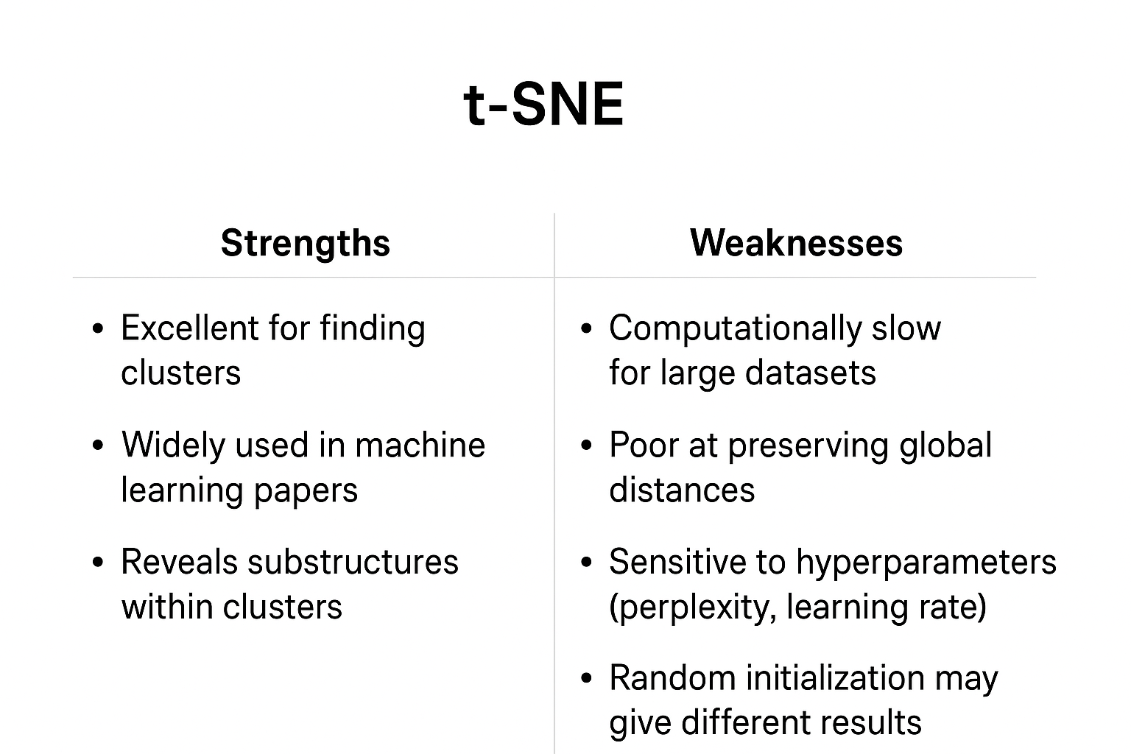
Strengths & Weakness of t-SNE

Slide 7
UMAP
Stands for Uniform Manifold Approximation and Projection
Based on manifold learning and graph theory
Focus: Preserve both local and global structure
Faster than t-SNE

Slide 8
How UMAP Works
Builds a graph of high-dimensional data
Optimizes a low-dimensional layout to preserve neighborhood relationships
Parameters:
n_neighbors → local vs global balance
min_dist → controls cluster tightness

Slide 9
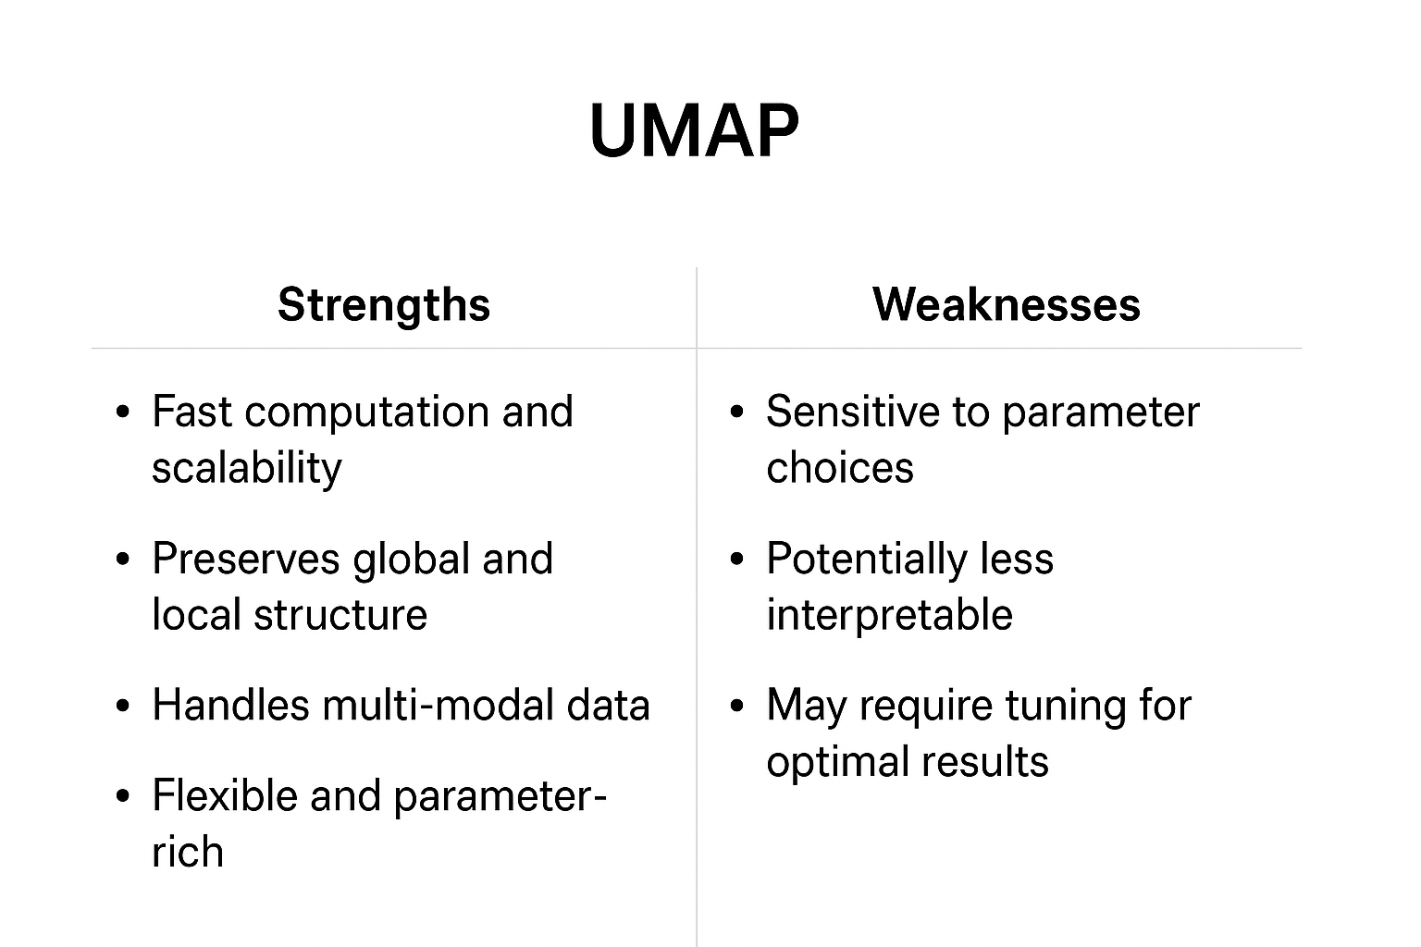
Strengths & Weakness of UMAP

Slide 10
Applications
t-SNE:
Data exploration in research papers
Visualizing embeddings (NLP, computer vision)
UMAP:
Large dataset visualization
Preprocessing for clustering/classification
Single-cell RNA sequencing analysis

